Slide 1

CANARA ENGINEERING COLLEGE Sudhindra Nagara, Benjanapadavu, Mangalore– 574219, D.K Karnataka
DEPARTMENT OF COMPUTER SCIENCE AND ENGINEERING
GENERATIVE AI POWERED MODERN EDUCATION TOOL TO ENHANCE TEACHING- LEARNING EXPERIENCE
Pratheek Nayak B K 4CB21CS072
Shivani A S 4CB21CS102
Skanda B H 4CB21CS110
V Suraksha Pai 4CB21CS120
GUIDE: Prof. Babitha Ganesh Kulal
Evaluation Date:02-12-2024

Slide 2
Content
Introduction 3
Problem Definition 4
Objectives 5
Literature Survey 6
Functional and Non-Functional Requirements 11
Design Constraints 17
Implementation 18
Results and Discussion 19
Conclusion and Future Scope 22
Bibliography 23

Slide 3
Introduction
Enhances Traditional Learning: An extension of the traditional teaching approach to increase its effectiveness.
Differential Experiences of Learning: Promotes personalized learning, designed to suit individual requirement and preference.
Building Adaptive Learning Culture: Strives to develop an effective and responsive learning environment in terms of the given forms of needs for learning.
Saves time for Virtual mentoring and immersive environments : Provides excellent interactive experiences that bring about a dynamism of learning.

Slide 4
Problem Definition
Problems faced by students:
Traditional methods lack the flexibility to allow for hands-free control and efficient problem solving.
Time consumption:
Tutors/Educators spend more time creating study resources for students.
Need/Solution:
There is a need for an educational platform that not only supports students but also empowers tutors by offering more interactive and engaging teaching methods.
Enable hands-free teaching with the convenience of voice commands, enhancing the teaching experience.

Slide 5
Objectives:
Obj 1: To create a modern education tool integrated with generative AI to enhance the overall quality of the education.
Obj 2: To implement the robust voice command system that allow teachers to interact with platforms hands free.
Obj 3: To incorporate Natural Language Processing(NLP) to automatically correct and suggest improvement in the text providing teachers with real time feedback.

Slide 6
Literature survey :
Project Title | Problem Addressed | Implementation and Results | Limitations
A simple Approach for scripting in Air and Display using computer Vision | Due to pandemic there was a lack of educational tools that can makes Student understanding better way. | Proposed a model where we can write in air using our and fingers and can be saved for later use. | There was no voice control Over their drawing and for better understanding the color changing option is not available.
The virtual air canvas using image processing | To solve the problem that enable users to draw in the air and detect hand emojis in front of a video feed. | The air canvas allows users to use their fingers to draw or write in the air with the system detecting and tracking the movement of their fingertips. | If the user want to draw the perfect shapes this feature is not available.
Air Canvas : Ex-pressing Creativity in the Real world with OpenCV and Python | To solve the problems faced in online education | It allows content to be delivered in real space and allows us to draw our needs by holding fingers in air there are different colors and shapes. | There is no voice control feature where we speak a sentence and it will be displayed on the screen.

Slide 7
Literature survey :
Project Title | Problem Addressed | Implementation and Results | Limitations
The virtual canvas for interactive learning using OpenCV | The concept tack-les the challenge of engagement in online education, as traditional methods often leave students feeling isolated and unmotivated | The solution proposed was the virtual canvas where we can draw in air using different colors and shapes for better understanding.. | The solution wont be provided with the answer if we write a question and there is no auto correction.
Transforming Teaching and Learning with Hand Gestures | Using hand gestures in teaching helps overcome challenges like misunderstandings, disengagement, and diverse learning styles. Traditional methods can leave students feeling disconnected and hinder retention. | We can draw and write in air using our fingers and also color changing of the pen is available. | There is no readymade shapes that can be used to draw easily.

Slide 8
Literature survey :
Project Title | Problem Addressed | Implementation and Results | Limitations
Chalk-Free Instruc-tions through HandGestures: Bridgingthe Gap in Digi-tal Education Air Canvas Using OpenCV And Medi-a pipe. | The article high-lights the challenge of engaging students in digital education, where traditional methods like chalkboards fall short. The Air Canvas project addresses the need for a hands-free, gesture-based digital drawing tool, overcoming challenges like accurate hand tracking, smooth line creation, and intuitive gesture recognition for seamless interaction without physical tools. | Hand gesture recognition was an interactive presentation in chalk-less presentations. The students were much more interested and understood the topic far better. Reactions were mostly positive. The Air Canvas project achieved a responsive, hands-free drawing experience, enabling users to draw, erase, and change colors using hand gestures with accurate tracking and smooth controls. | There is no voice commands to change the slides for faster working There is no voice assistant for hand-free drawing which makes the work easier

Slide 9
Literature survey:
Project Title and Author | Problem Addressed | Implementation and Results | Limitations
Air Canvas: Draw in Air | The limitations of traditional digital drawing tools by proposing a gesture-based system that allows users to create 3D drawings using intuitive hand movements, enhancing interactivity and accessibility in digital art creation. | The gesture-based system enables users to create 3D digital drawings with intuitive hand movements, achieving effective real-time tracking and accurate shape representation while increasing user engagement and creativity. | There is no voice control feature where we speak a sentence and it will be displayed on the screen.
Virtual Air Canvas | The gesture recognition for 3D drawing, real-time feedback, and color tracking for precision, all while enabling hands-free operation and integration with digital tools. | The results show that the gesture recognition system enables users to create 3D drawings with intuitive hand movements, resulting in increased engagement and creativity. | There is no voice activated Commands to change the slides.

Slide 10
Literature survey:
Project Title and Author | Problem Addressed | Implementation and Results | Limitations/Future Scope
Creating Air Canvas Using Computer Vision | It addresses the limitations of traditional digital drawing tools, which often restrict artistic expression due to their reliance on physical devices | The results was that users can create precise3D drawings in real time with intuitive hand gestures, demonstrating effective gesture recognition. Users reported enhanced creativity and enjoyment, indicating that the hands-free approach significantly improves accessibility and engagement for all skill levels | There was no readily available shapes to draw which was makes the drawing process harder

Slide 11
Gaps Identified:
Many systems focus on gesture-based interactions but often overlook voice assistance integration.
Limited features in terms of customization, cross-platform compatibility, and third-party integration.

Slide 12
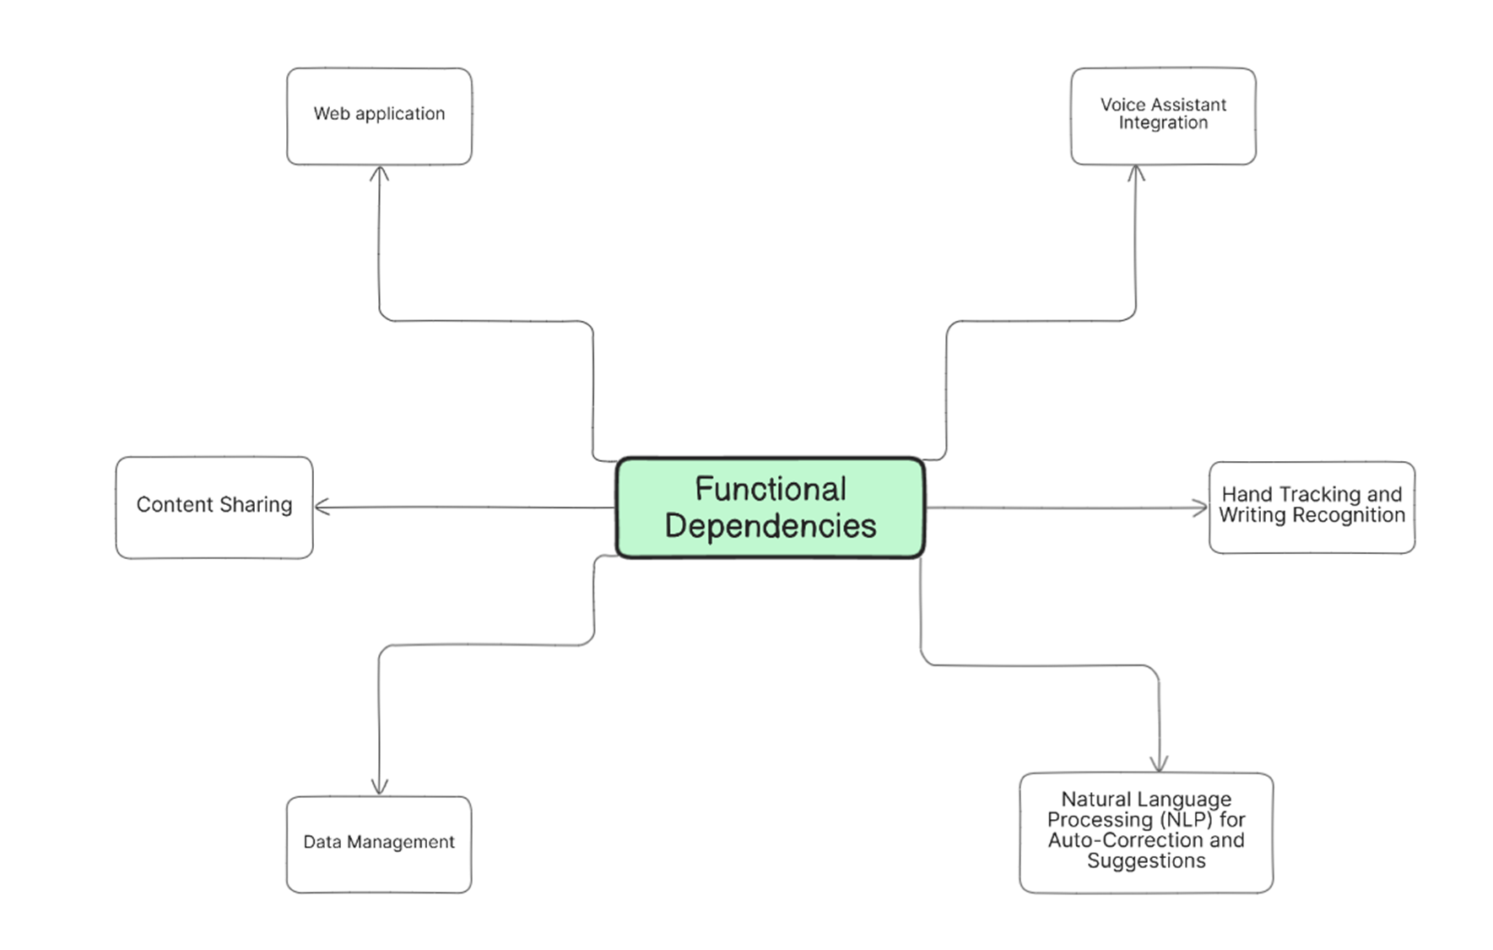
Functional and non-functional requirements
Functional Requirements:
Fig 1: Functional requirements

Slide 13
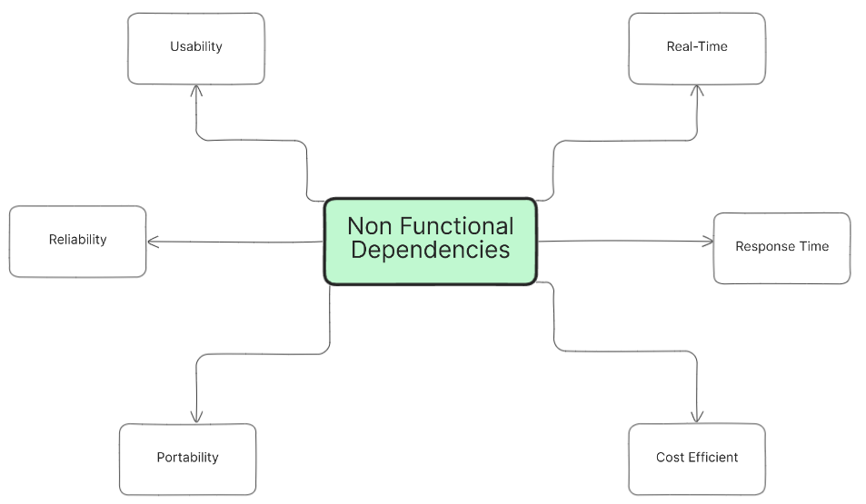
Functional and non-functional requirements (continued)
Non-Functional Requirements:
Fig 2: Non-Functional Dependencies

Slide 14
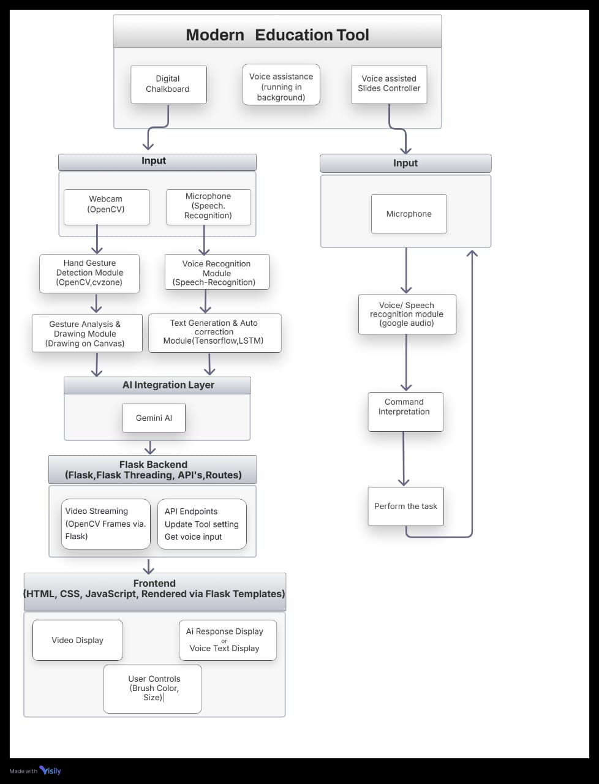
Methodology
Fig 3: Methodology diagram

Slide 15
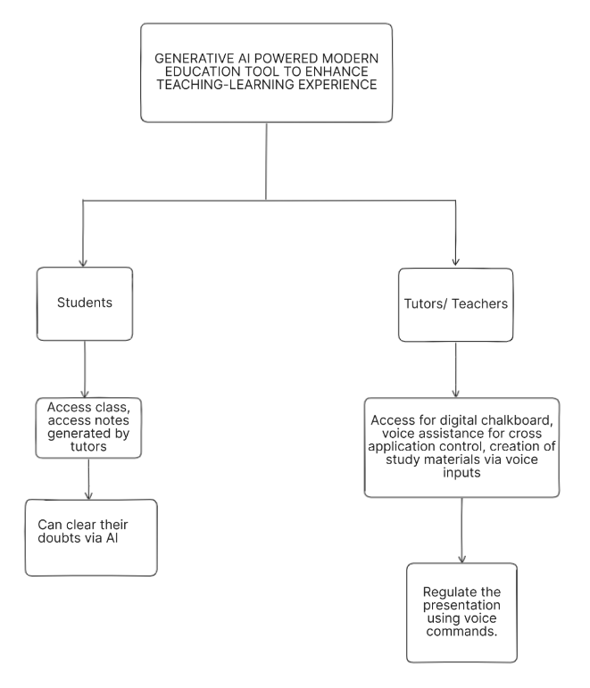
Diagrams
Fig 4: Modular Diagram

Slide 16
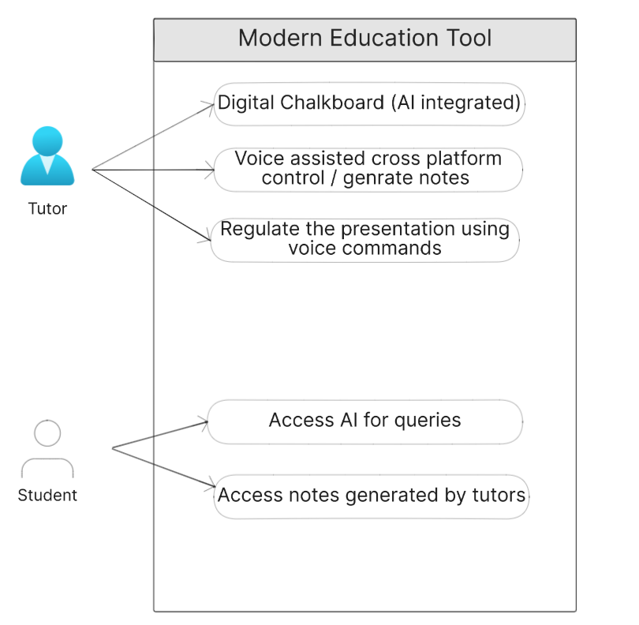
Fig 7: Use case diagram

Slide 17
Design Constraints
Lighting Conditions
Clear Background
Real-Time Processing
Voice Clarity
Cross-Platform Compatibility

Slide 18
Implementation
Frontend Development
HTML
CSS
JavaScript
Python Framework
Flask
APIs
Gemini AI
Libraries:
Flask-SocketIO
Speech Recognition
Pyttsx3
OpenCV
Tesseract OCR

Slide 19
Results and Discussions
Real-time command interpretation enables effective control of applications through voice commands.
Accurate hand gesture tracking allows users to:
Draw, erase, and interact seamlessly with a chalkboard.
Integrated AI model processes voice commands and text inputs to:
Clear doubts.
Provide suggestions for enhanced learning experiences.
Voice-controlled PowerPoint presentations support:
Smooth slide navigation without physical interaction.
Customization features, controlled via voice commands, include:
Changing brush color and thickness.
Adjusting background settings.
The tool is highly adaptable to various user preferences.

Slide 20
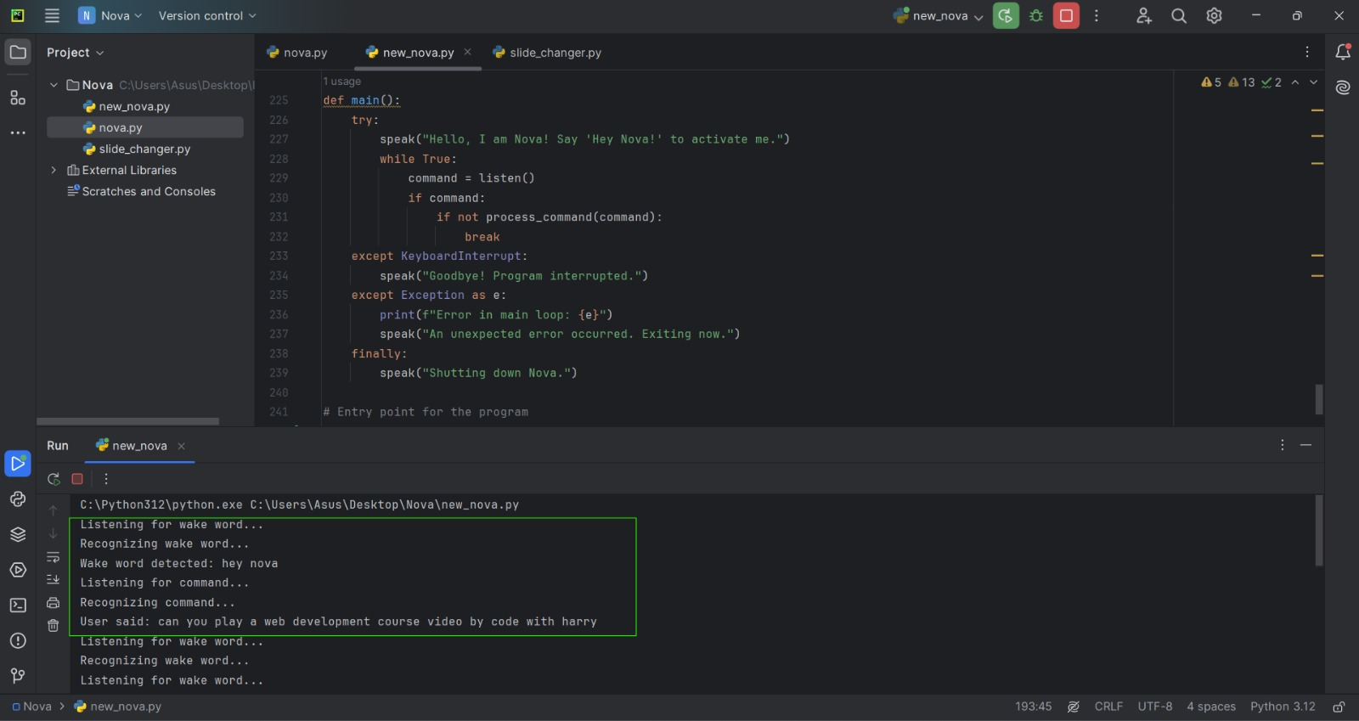
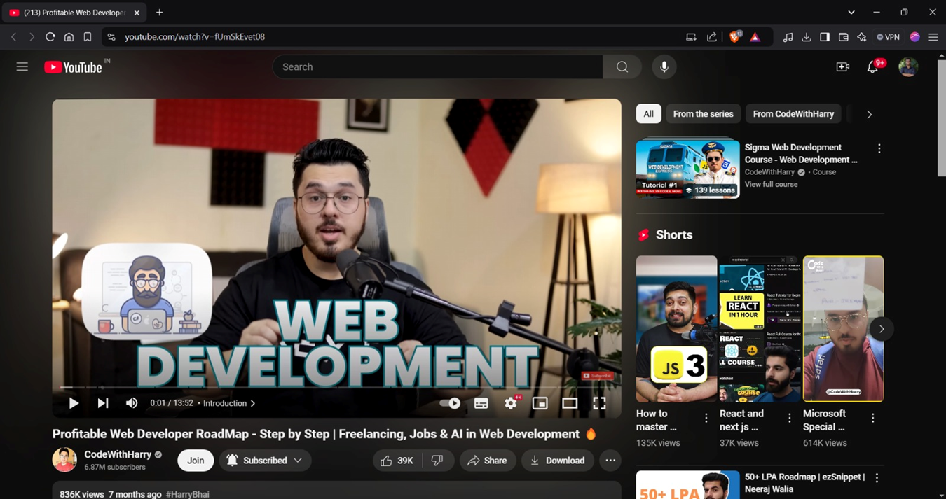
Screenshots

Slide 21
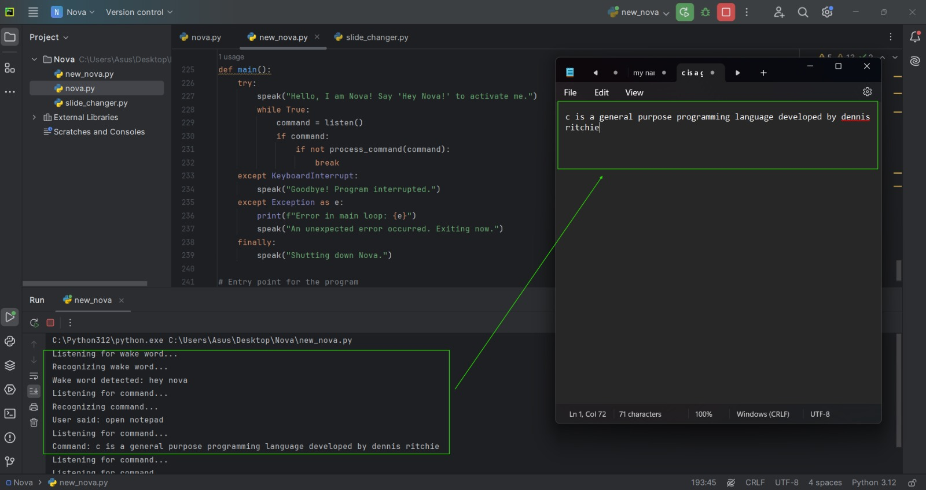
Screenshots (continued)

Slide 22
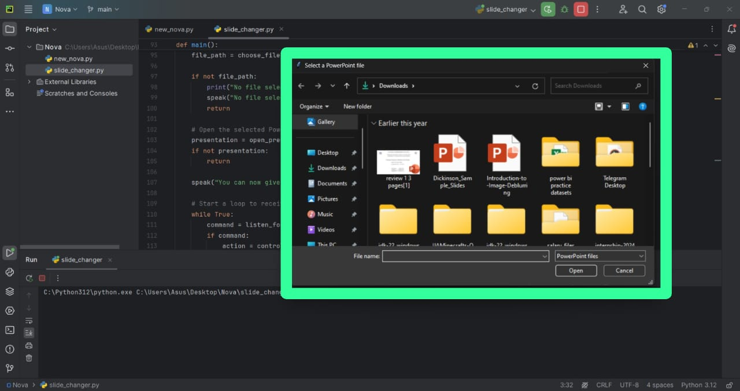
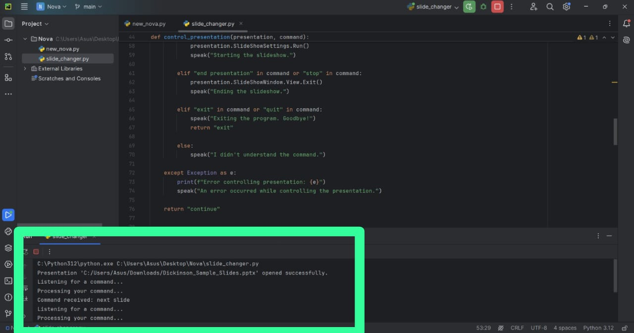
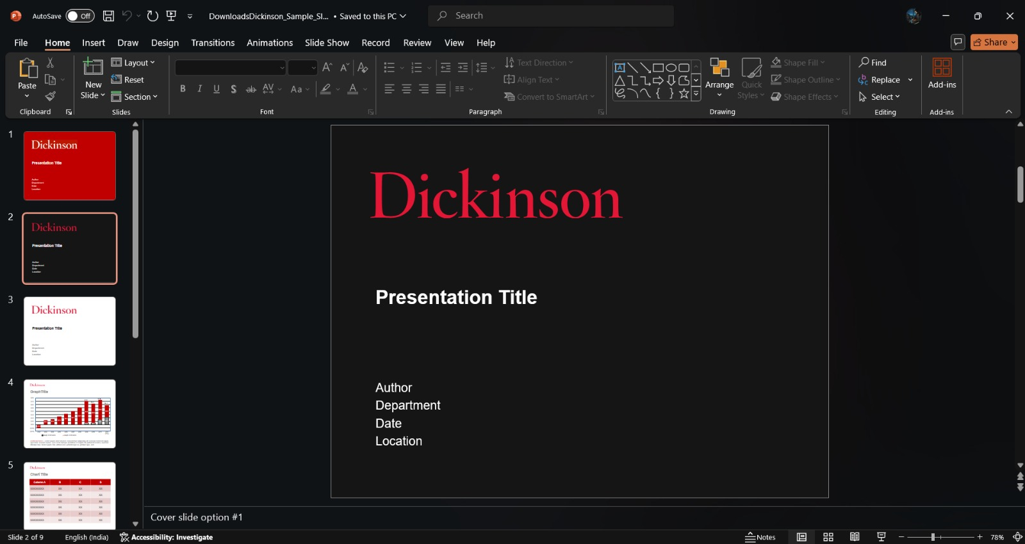

Screenshots (continued)

Slide 23
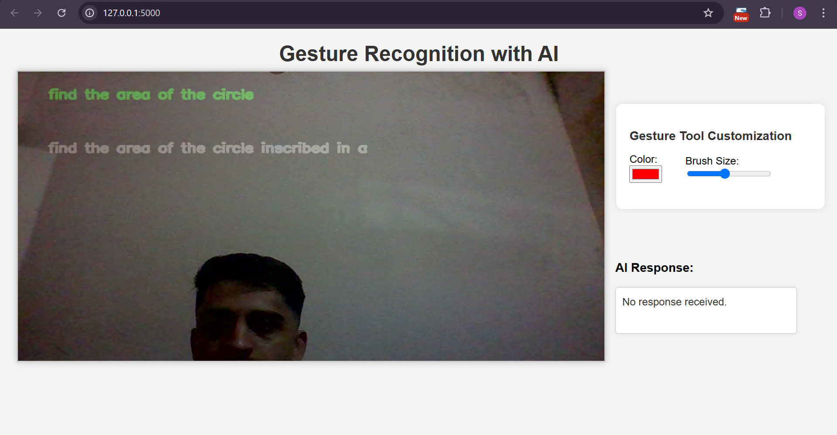
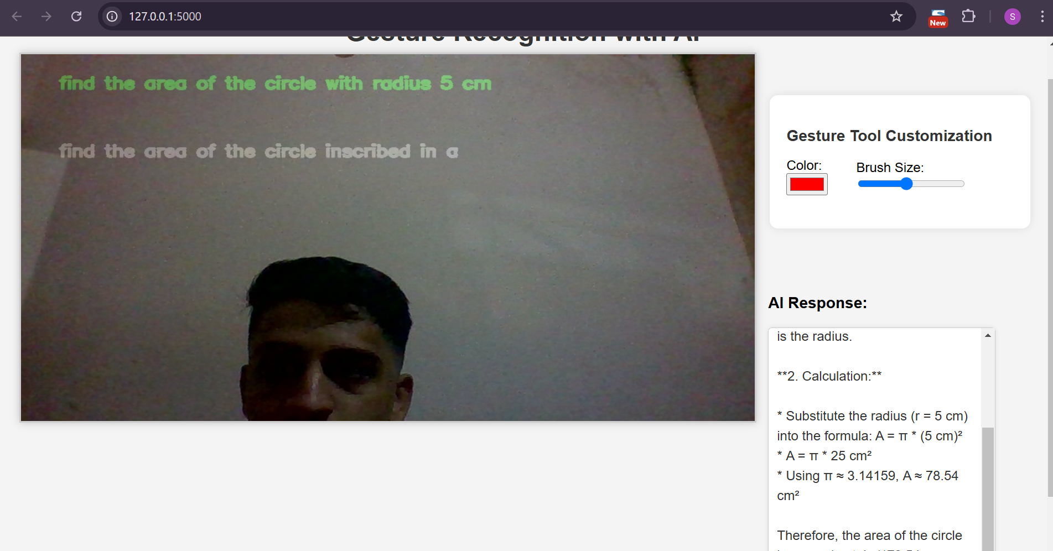
Screenshots (continued)

Slide 24
Conclusion and Future Work
This application aims in integrating effective interacting learning, hands free teaching/learning feature and ensure time saving feature improves the overall efficiency of the teaching and learning process.
Future scope:
(i) Students monitoring system for tutors.
(ii) To make it a platform that allows multiple users to join an online session concurrently, ensuring broad participation and engagement.

Slide 25
Bibliography
[1] DV Bhargav et al. “A Simple Approach for Scripting in Air and Display using Computer Vision”. In: 2021 IEEE International Conference on Mobile Networks and Wireless Communications (ICMNWC). IEEE. 2021, pp. 1–4.
[2] K Pavithra, A Geetha, and R Chinnaiyan. “The Virtual Air Canvas Using Image Processing”. In: 2023 International Conference on New Frontiers in Communica-tion, Automation, Management and Security (ICCAMS). Vol. 1. IEEE. 2023, pp. 1–6.
[3] A Suresh et al. “Air Canvas: Expressing Creativity in the Real World with OpenCV and Python”. In: 2023 International Conference on Energy, Materials and Com-munication Engineering (ICEMCE). IEEE. 2023, pp. 1–5.
[4] Palak Rai et al. “Virtual canvas for interactive learning using OpenCV”. In: 2022IEEE 3rd Global Conference for Advancement in Technology (GCAT). IEEE. 2022,pp. 1–5.
[5] B Chandana et al. “Transforming Teaching and Learning with Hand Gestures”. In:2024 OPJU International Technology Conference (OTCON) on Smart Computing for Innovation and Advancement in Industry 4.0. IEEE. 2024, pp. 1–5.

Slide 26
Bibliography
[6] V Ramachandra H et al. “Virtual Air Canvas Using OpenCV and Mediapipe”. In:2022 International Conference on Futuristic Technologies (INCOFT). IEEE. 2022,pp. 1–4.
[7] Sayli More et al. “Air Canvas: Draw in Air”. In: International Research Journal of Engineering and Technology (IRJET) Volume 9 (2022).
[8] Atharva Hoshing et al. “Chalk-Free Instructions through Hand Gestures: Bridging the Gap in Digital Education”. In: ().
[9] Akhil Mohan et al. “Virtual Air Canvas”. In: ().
[10] Ajoy Ketan Sarangi and Rudra Prakash Pradhan. “ICT infrastructure and economic growth: A critical assessment and some policy implications”. In: Decision 47.4(2020), pp. 363–383.

Slide 27
Thank You

